Slide 1
Whiz Kids
Tutor Training, Site Specific
~ What ~ Who ~ When ~ Where ~How ~

Slide 2
Training Agenda
  Site Specific Information for Tutors
  What? Who? When? Where? How?
  First Day – Meeting your Whiz Kid
  The Amazing Tutoring Hour
  Curriculum Materials
  Literacy Tutoring
  Building Relationships
  What did you learn? Self Quiz

Slide 3
What and Who is Whiz Kids
WHAT?
City Gospel Mission Whiz Kids is:
      a 1-to-1 tutor/ elementary student ratio.
      a READING tutoring program.
      helping people know Jesus better.
WHO?
  Your Whiz Kid student will be behind in reading, and/or
  needing of a caring adult in his or her life.
  Children are offered Whiz Kids tutoring through their school
  and with parental permission.

Slide 4
Site Specific Information
When?
Your Whiz Kids will meet every week on _____________.
Each Whiz Kids session will run from _____ - _____.
Your site will begin the year on ____ and end in Spring on ____.
Each week tutors should arrive no later than _____.
Whiz Kids students are scheduled to arrive at _____ and leave at _____.
Tutors can expect to leave at _____.
Reminder: No School = No Whiz Kids (includes Snow Days, etc.)

Slide 5
Site Specific Information
Where?
Upon arriving, tutors should sign-in _____.
Tutors should meet their Whiz Kid _____.
Tutoring will actually take place _____(room, space, table, seat)?
Restroom locations: For tutors? For girls? For boys?
(A tour will be offered following this meeting for new tutors.)

Slide 6
Site Specific Information – How?
  Site Leaders: _________________; _____________________
  Email: __________________________; _____________________________
  Cell phone #: ______________________; ________________________
  Emergency drills/evacuations; safety training prerequisites; etc.
  Organization and storage of supplies made available for tutors and students. For example:
  √ Snacks? √ Name Tags? √ Curriculum materials?
  √ Supplies/tutoring tools ? √ Supplemental materials and
  equipment (books, Bibles, games, paper puzzles, etc.)?

Slide 7
More Site Specific Information – How?
ATTENDANCE – honor time commitment by reporting tardiness or absence to __________ as far in advance as possible.
CONNECTING WITH THE FAMILY – when and how?
CONNECTING WITH THE SCHOOL – how should teachers be contacted and by whom?
SITE STAFFING NEEDS? – looking for additional leaders? volunteers? snacks? set up? clean up? transportation monitors? tutor email communication/phone tree?
sub-tutors? other?

Slide 8
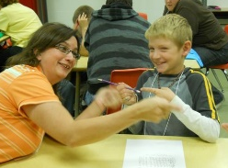
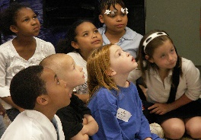
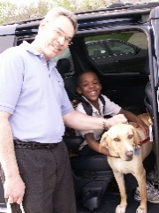
First Day
What will your first day look like?
      Tutors and Whiz Kids will be matched up. This activity will be as creative as you want t to be.
Whole group led by a Site Leader -
Prayer
Discuss expectations, rewards, & consequences for misbehavior.
Practice transitions – moving from whole group to tutoring
orderly and quietly
Tutor and Student Together - Getting Acquainted Activity
Optional other activity or craft tutor and student can do together
Meet the family, if possible.

Slide 9
Behavior Expectations & Routines
Good conduct doesn’t just happen!
  Every tutor monitors every Whiz Kid during any and all transitions and activities.
  Be Proactive – Set routines, expectations, and consequences up front so they are
  clear to everyone. Follow the school’s behavior plan. Revisit periodically as needed
  [Also refer all Volunteers to City Gospel Mission’s “Youth Protection Policy & Procedures” document.]
Some Key Whiz Kids Rules:
No cell phones or individual music devices are allowed for students or adults unless for curriculum use.
Tutor and child must stay within sight of each other (except in bathroom).
Tutors must never be alone with a student.
No disruptive behavior - use inside voices and quiet games.
Treat everyone and everything with kindness and respect.
Think first & be safe. For example, walk / don’t run.

Slide 10
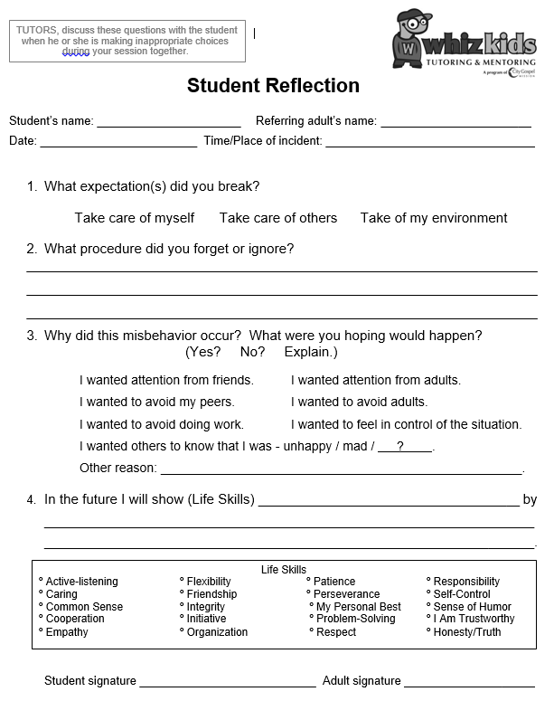
  BEHAVIOR EXPECTATIONS & ROUTINES (Continued)
  Children actually want clear boundaries.
  Consistent misbehavior needs private consequences. A suggested plan looks like:
  1st major offense -- Tutor speaks to student with Site Leader; completes a
  “Student Reflection” Form.
  2nd offense -- Tutor and Site Leader discuss issue
  with parent/ guardian, preferably in person.
  3rd offense -- child is removed from Whiz Kids
  activity or specified period of time.
(Although expulsion from the program is not the
preferred plan, remember that kids need to learn
proper boundaries. Perhaps a second chance can
be offered in the future if the child is remorseful
and ready to try again.)
  This “Student Reflection” form
  is available from your Site Leader.

Slide 11

The Amazing Tutoring Hour
First 5 – 10 minutes: Meet – Greet – and discuss the week:
May include, for example:
- prayer
- “More About You & Me” conversation prompts
- brain teaser or puzzle
30 – 40 minutes: THE MOST IMPORTANT ACTIVITY
- READING with tutor demonstrating & coaching
- Completing the Curriculum Packet materials
10-15 minutes: Be tutor-intentional, not student-led.
- tutor reads aloud* from a chapter book
*Hearing an adult read fluently and expressively
models a student’s goal in reading.
- homework help
- play a thinking or educational game
- work on a craft or writing project
Last 5 minutes: Closure
- Pray together
- Put away materials and clean area
- Tutor completes the Reading Progress Log
- Walk student to drop off area; meet the parents

Slide 12
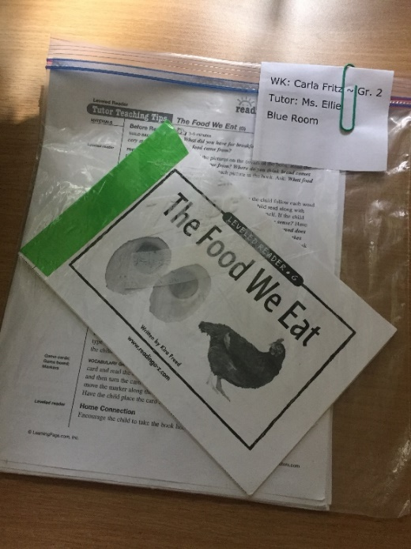
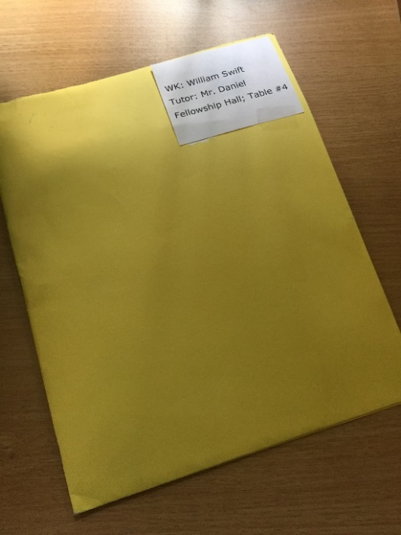
Tutoring Supplies and Materials
These are available to every Whiz Kid and tutor volunteer every week:
Everyday Tools Curriculum Packet (Bag or Folder)
pencils and pencil sharpener, with receptacle
eraser
glue stick
scissors, rounded
Coloring tools: crayons, colored pencils, or markers
spiral notebook
index cards (optional: hole punch & notebook ring)
Optional:
dry erase board with marker & eraser
Dice or deck of cards (for basic math practice)
Children’s Bible, dictionary, or Thesaurus

Slide 13
ReadingA-Z.Com Curriculum Packet materials:
A Leveled Book at your student’s reading level
The Comprehension Quiz to see if the child understands, or comprehends, what was read.
Worksheets and Graphic Organizer to help the student visually process and organize the contents of the book in a new way.
Levels F-Z: A Game with cards to practice new vocabulary and/or comprehension from the book. [Some cards are used like Concentration; others include a game board.]
Levels F-Z: Two of the same Fluency Assessment Passages at the same level as the book.
[Lower levels: High-Frequency Sight Word Lists with 220 most-used words
for Grades K-3rd; provided by Whiz Kids]
A Bar Graph for the student to track their reading/high-frequency vocabulary Words Per Minute (WPM).
[Provided by Whiz Kids.]
A Reading Progress Log for the tutor to complete at the end of every session.
~~~~~~~~~~~~~~~~~~~~~~~~~~~~~~~~~~~~~~~~~~~~~~~~~~~~~~~~~~~~~~~~~~~
*** Reading-Tutors.Com is no longer offered by LearningA-Z parent company. One-page “Tutor Teaching Tips” are no longer available. However, Whiz Kids offers a generic tutor teaching tips document on its Resource page.
For similar resources in ReadingA-Z, go to the home page → RESOURCE button (at left on red bar); → “Focused Instruction” → “Tutoring & Mentoring” under INTERVENTION → “Instructional Packs” in the blue box → “Fluency and Comprehension Packs” at the bottom. Click on the level in the rainbow alphabet F-Z.

Slide 14

Exploring the CURRICULUM PACKET
→ A-Z Leveled Book
Level F
Approximate Reading Level Equivalents:
aa - a - B - C - D Pre-K → Kindergarten
E - F - G - H - I – J 1st Grade
K - L - M - N - O – P 2nd Grade
Q – R – S – T 3rd Grade
U – W 4th Grade
X - Z² 5th Grade +
***Tutors should move their students up through the levels as quickly as possible without frustrating the student into non-compliance. Our goal is to get our Whiz Kids reading on grade level as soon as possible.

Slide 15
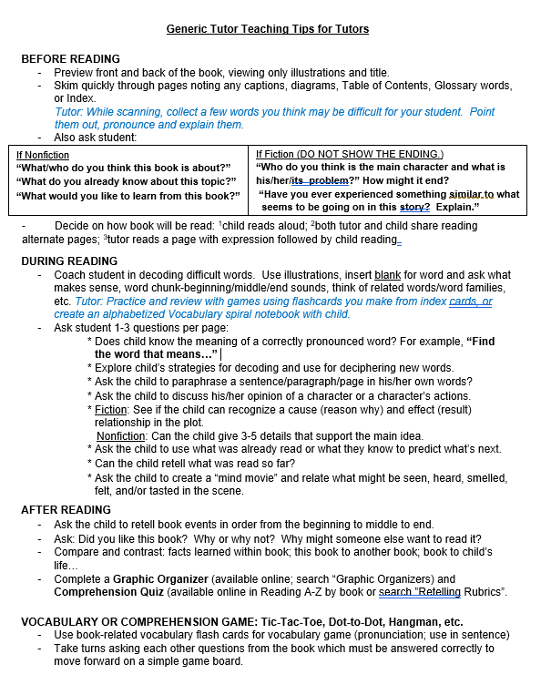
Exploring the
CURRICULUM PACKET
Generic Tutor TeachingTips:
Available from your Curriculum Leader
Coaching Reading ideas
25-35 minutes of
Before, During, and After Reading

Slide 16
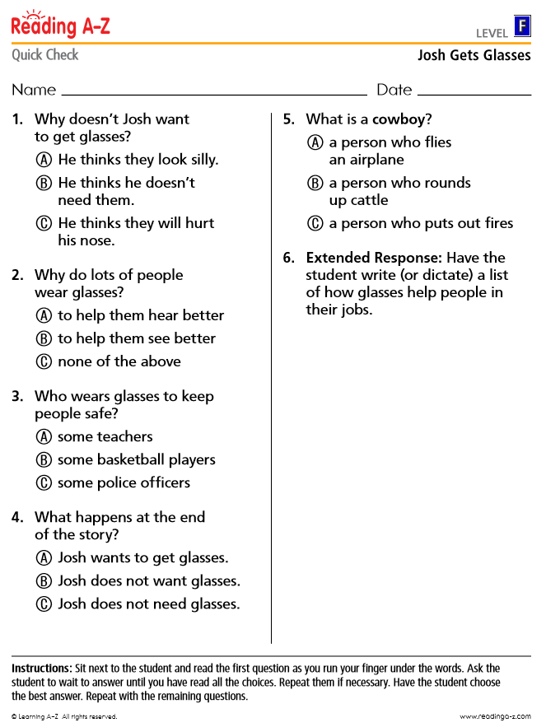



Exploring the CURRICULUM PACKET
Comprehension Quiz:
[ Levels F – Z only. ]
Read the questions together before reading the book.
Teachers want the students to think in complete thoughts, and therefore to answer the “Extended Response” question by writing their answer in a complete sentence(s).
Have student find the page and text that proves his/her answer correct.

Slide 17
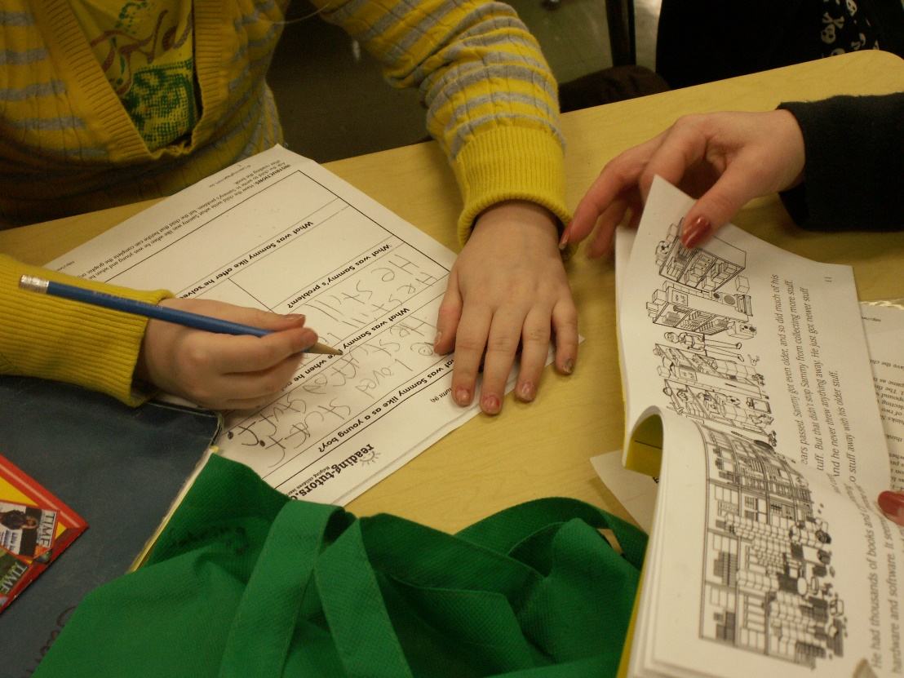
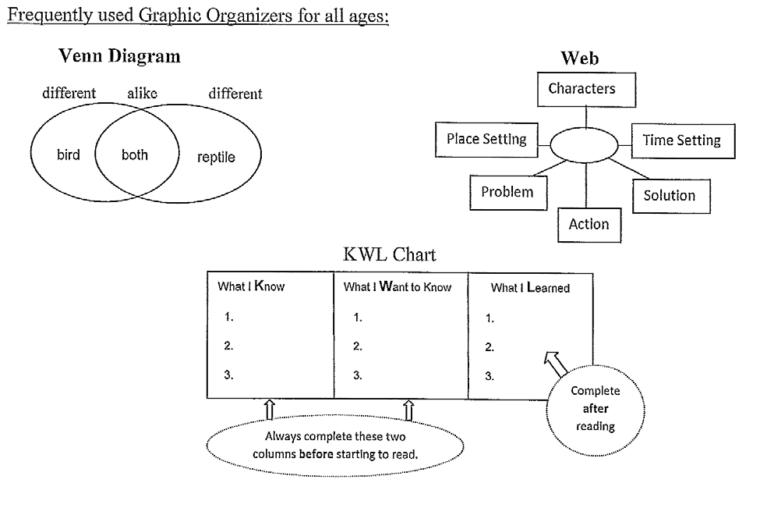
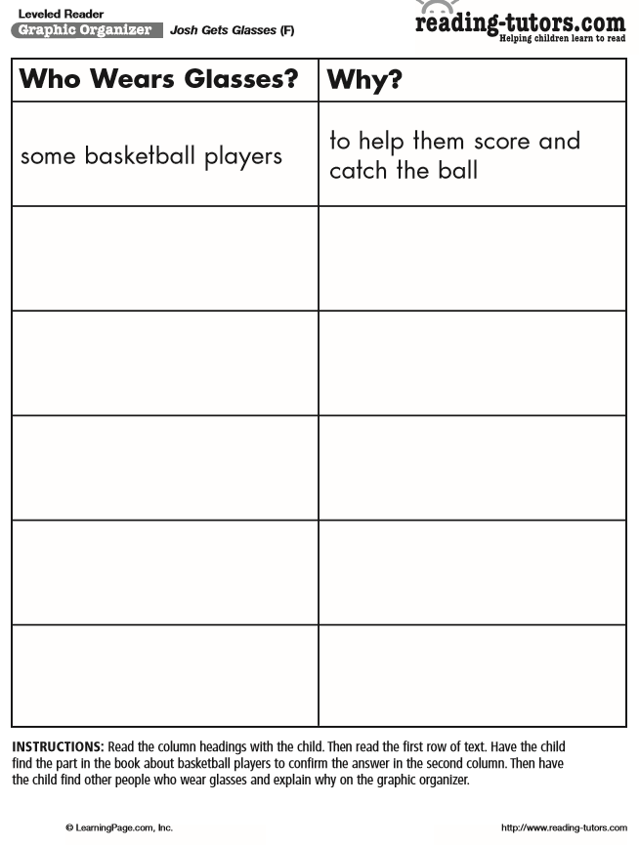
Exploring the CURRICULUM PACKET
Graphic Organizers…
This is a KEY ACTIVITY for students to review concepts and demonstrate understanding after reading occurs.
- Graphic Organizers come in many graph and chart formats.
- Instructions are included on the bottom of the paper.
Here are just a few examples of what you might find in your packet to match the book:
Story Web
Title
Before Reading
After
This is a good time for your student to practice writing in complete thoughts, including starting with a capital letter and ending with a period.

Slide 18
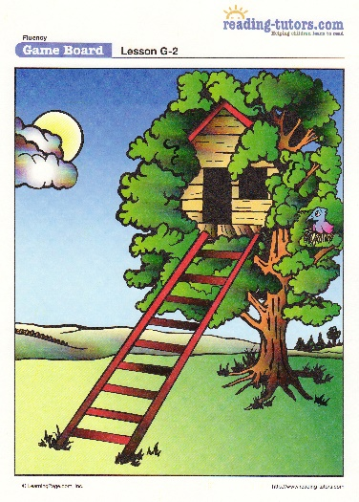
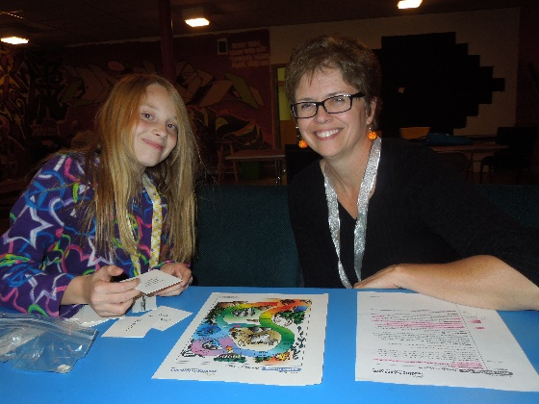
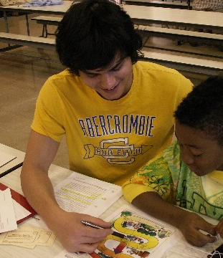
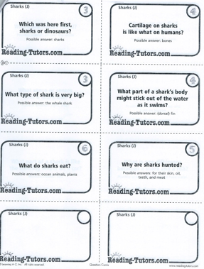
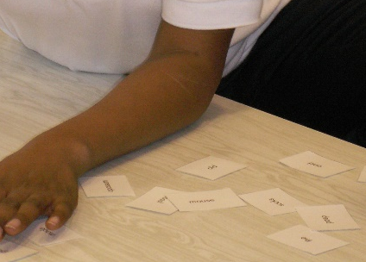
Exploring the CURRICULUM PACKET
Skill Practice Game:
The game that comes with the book practices its new vocabulary words or comprehension concepts.
Possible
Game Boards
Make up your own game:
Play
with your student. It’s no fun to play alone.
X
O
Use newly learned words or comprehension questions to play Tic-Tac-Toe or Dot-to-Dot on a dry erase board.
DS
MJ
Game Cards to Cut-out

Slide 19
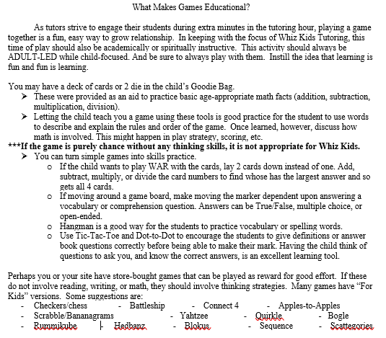
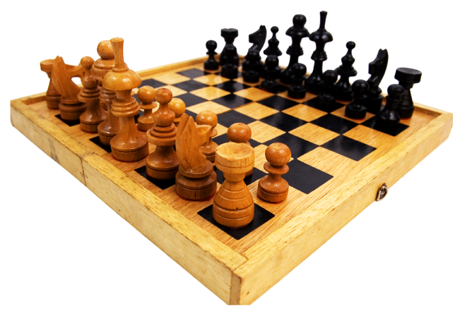
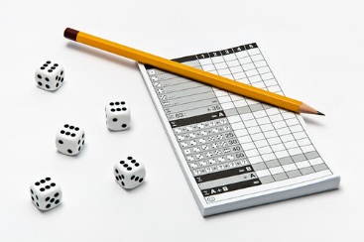
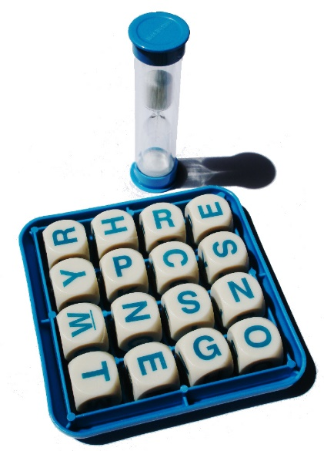

Optional Games:
Educational and Thinking Games can be used
as a reward for completing tasks.
Be tutor-intentional when choosing games.

Slide 20
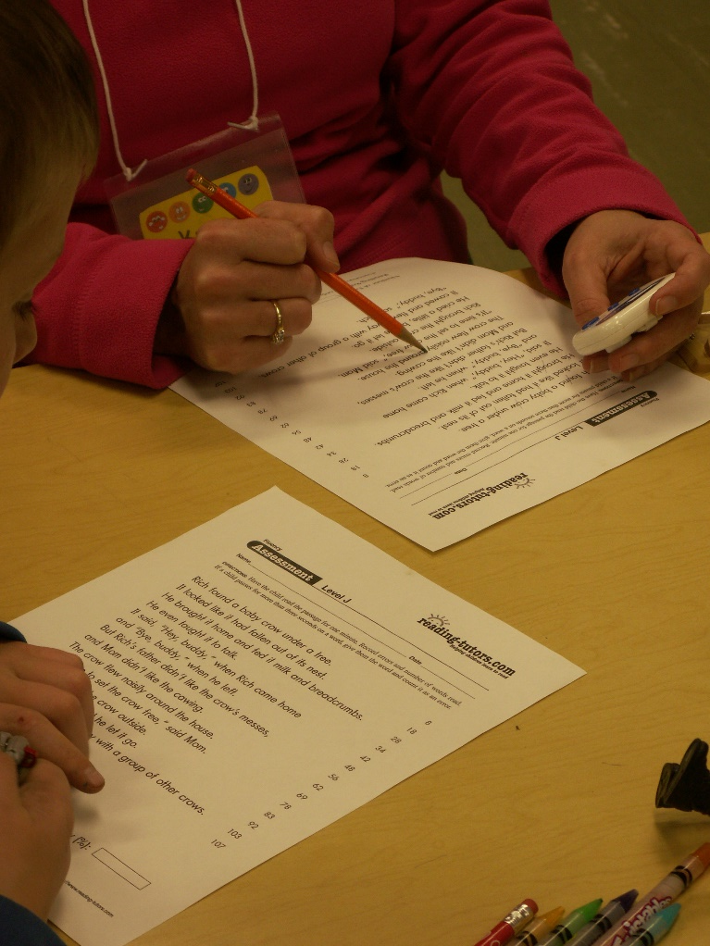
Exploring the CURRICULUM PACKET
1-Minute Fluency Assessment
Only for Levels F - Z
Your packet will provide two Fluency passages that match the same level as your Whiz Kid’s book level.
Ask your Whiz Kid to read the passage as best he/she until you say stop. Caution the child not to read too fast so careless mistakes are not made.
You will time your student as he or she reads the passage for one minute only.
While your child is reading aloud, you will be marking any places where a mistake is made.
After one minute, tell your child to stop. Mark where he or she stopped on your copy. Then find how many words were read. (For example, 64 words)
Next, show each mistake to your Whiz Kid and explain corrections. Make this a teachable moment. Then count up the number of mistakes.
(For example, 6 mistakes)
Ask your student to subtract the number of errors from the total number of words read. Now you have the Words Per Minute (WPM) rate of fluency. 64
- 6
58 WPM
IT’S IMPORTANT TO DO THIS EVERY WEEK!

Slide 21
CLARIFYING 1-MINUTE FLUENCY ERRORS
It is a MISTAKE when the child:
Skips a word or part of a word.
For example: correct – “She painted the wall a bright yellow color.”
incorrect – “She paint_ the wall a bright yellow color.”
incorrect – “She painted the wall a ___ yellow color.”
Mispronounces a word.
For example: correct – “They were hiding in the closet.”
incorrect – “They wear hiding in the closet.”
Substitutes an incorrect word.
For example: correct – “Mia splashed in the wet puddles.”
incorrect – “Mia jumped in the wet puddles.”
Reads words in the wrong order.
For example: correct – “We can do our homework.”
Incorrect – “Can we do our homework.”
Stops to try to figure out the word – ***Important to tell the child the word after you count silently to 3, and move on.
It is NOT a mistake when the child:
Adds words that do not change the meaning.
For example: correct – “I ran from the big dog”
Okay to say – “I ran away from the big dog.”
Repeats a word or words.
For example: correct – “It was a bright, sunny day.”
Okay to say – “It was a…it was a bright, sunny day.”
Self-corrects.
For example: correct – “They are very funny.”
Okay to say – “They are very furry…I mean, very funny.”

Slide 22
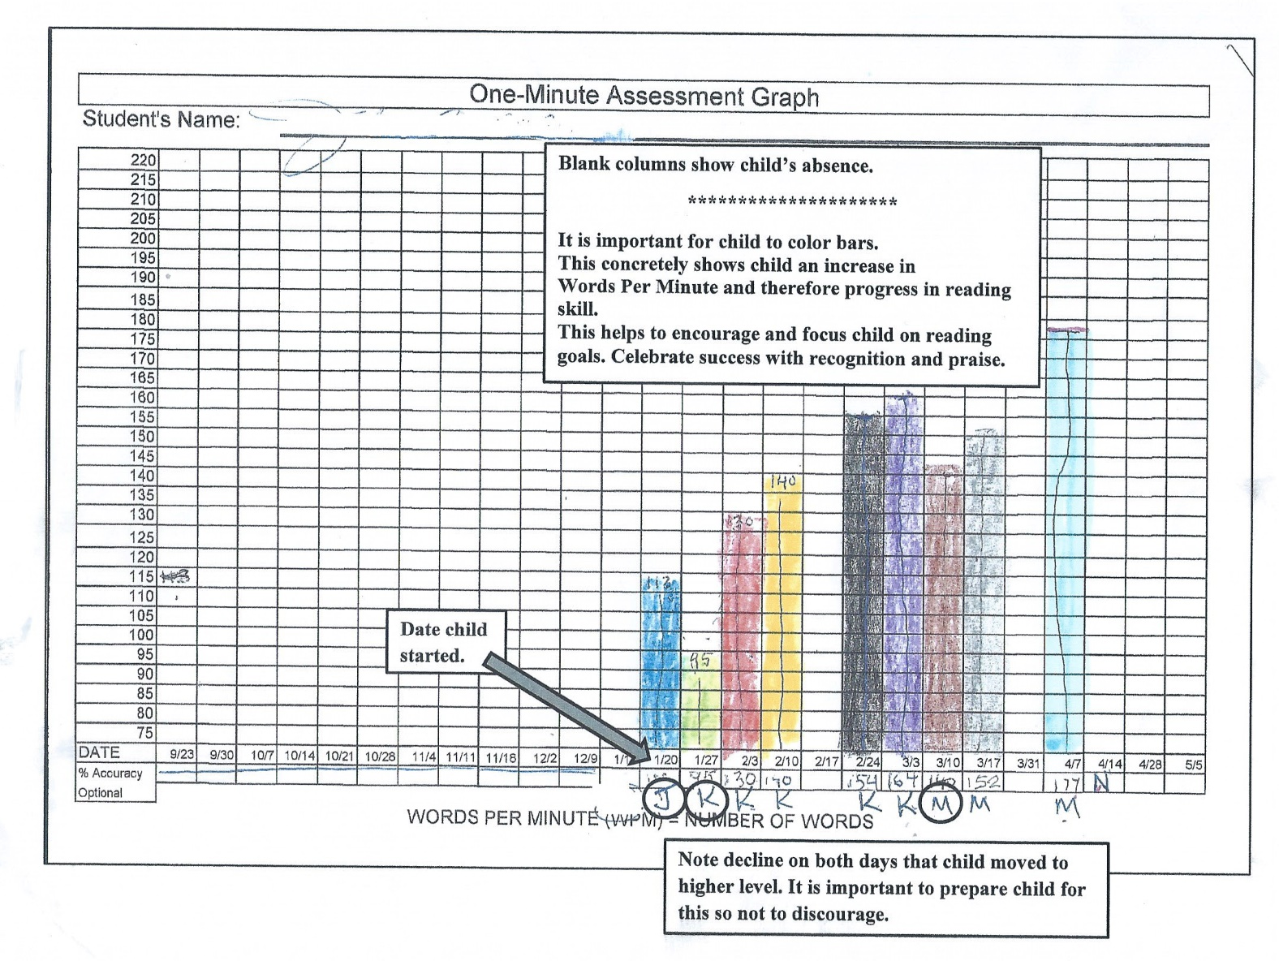
1-Minute Fluency Assessment Graph
Repeat this process every week with the same passage until the child moves to a different level.
*Repeating every week helps the student
remember, learn, and grow.
*Otherwise, the child may forget and show
less or no progress.
Each week, have your child add a bar to the graph to show his or her WPM score.
[This also practices a math skill.]
This is a great form of encouragement.
*Tangible, concrete proof of progress to the child.
*An opportunity for authentic praise each week
from tutor, Site Leader or parent.
Words Per Minute (WPM) is NOT an indication that your child is ready to move to a higher level.
- It does not assess an understanding of what was read.
- However, 80% WPM plus being able to retell the content of a new passage at the same level in detail can indicate moving up to a higher leveled book.
ALWAYS KEEP THIS AVAILABLE IN THE CURRICULUM PACKET.

Slide 23
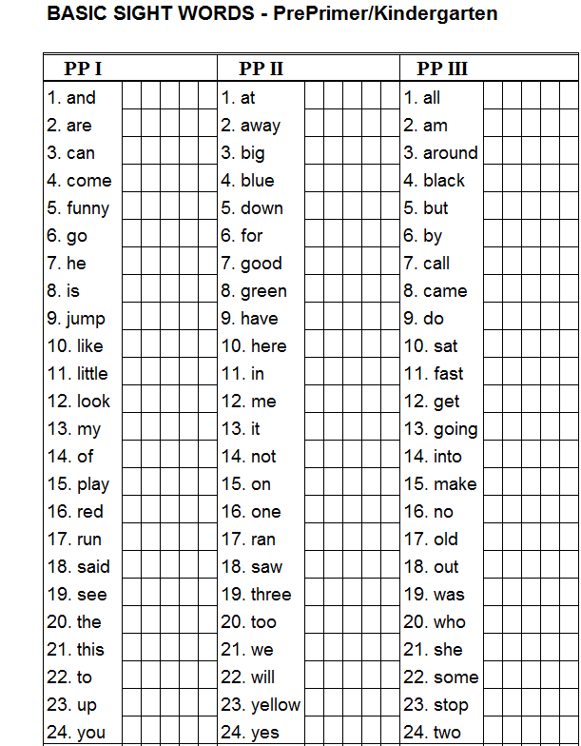
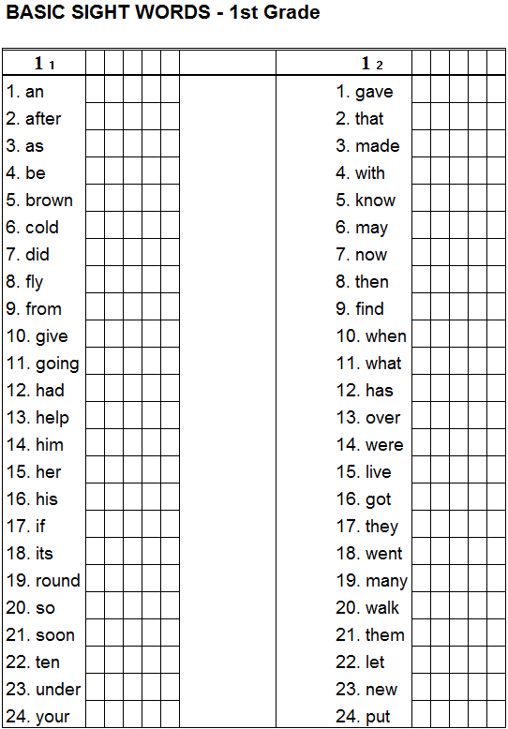
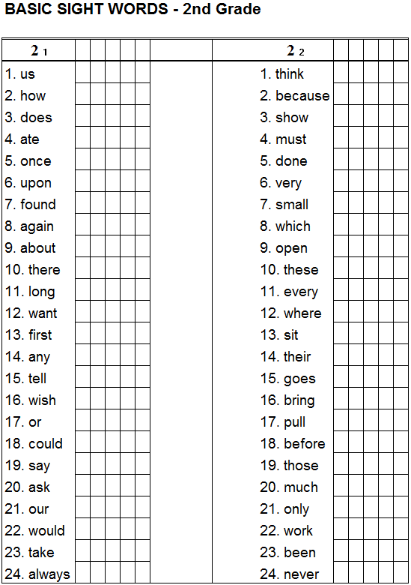
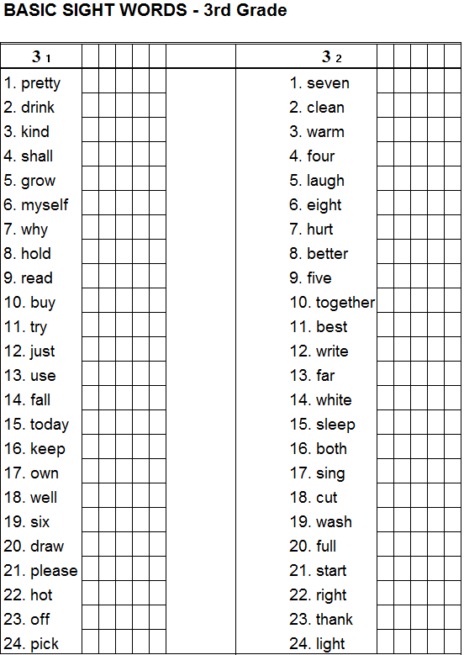
If your student is in Kindergarten – 3rd grade, or is reading below Level F, practice these wirds regularly.
These are “high frequency” words – the 220 most frequently found words in books that children read.
Every reader should recognize them by sight, and not have to decode them or sound them out.
Knowing these words can greatly improve a child’s reading fluency.
Basic Sight Words Lists
Follow the same assessment process as with the 1-minute fluency passages with each grade level page. Start with each row and work up to the whole page.
Make index cards to practice any words with which the child hesitates to say within 1 minute. These cards can be used as flash cards and/or in a game.
Note that learning these words in isolation does not make a “reader.” After learning the words “by sight,” they must also be able to understand their usage in the context of a passage. Therefore, also practice using these words in sentences.

Slide 24
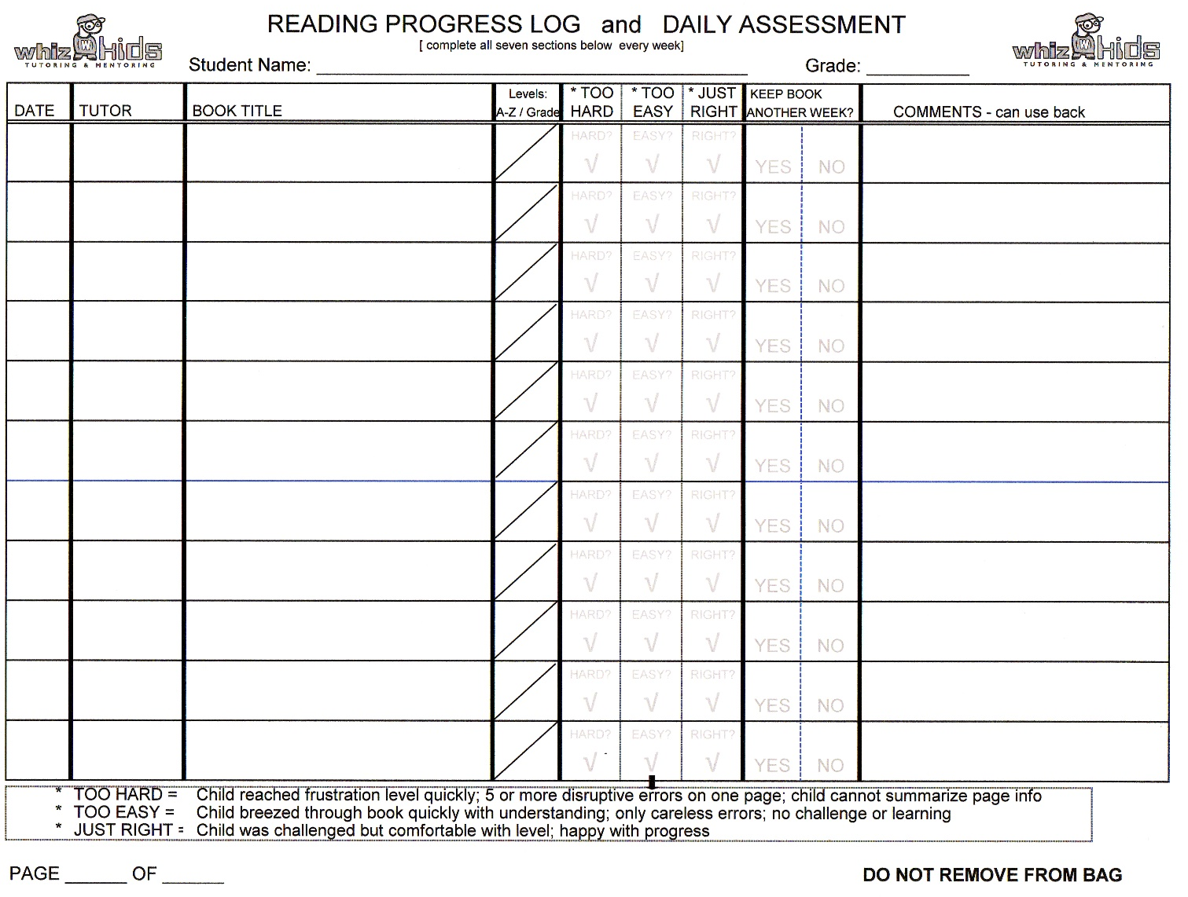
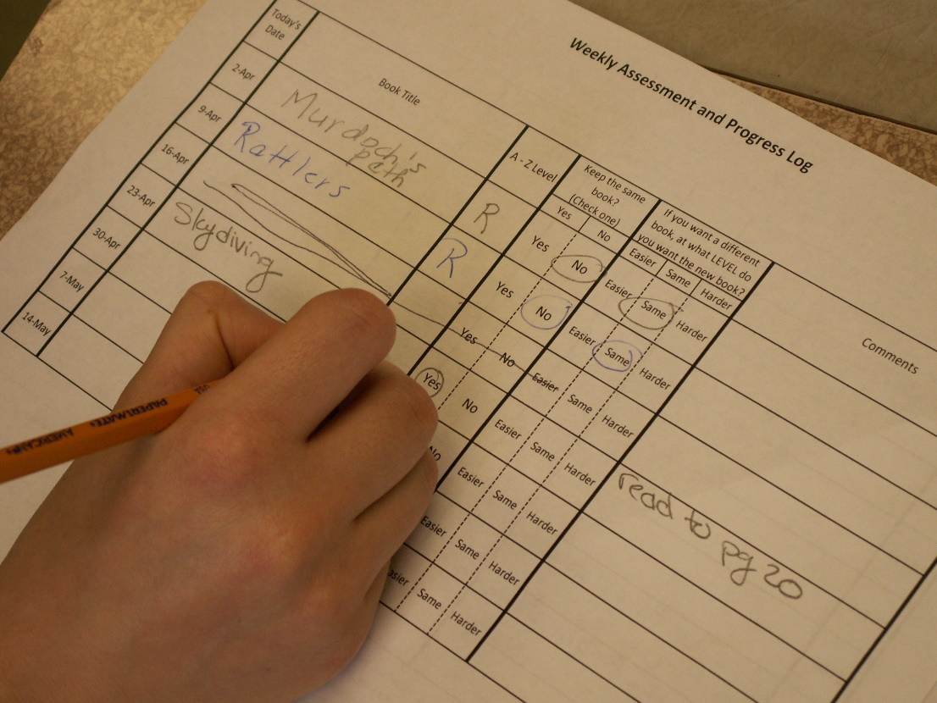
Exploring the CURRICULUM PACKET
Reading Progress Log:
5
2
DeLaney Sills
6
1
2
3
4
7
11/2
Sally
Josh Gets Glasses
F
still must do Gr. Org. + Game; review vocab.-cattle, police, score
11/9
absent
Complete at least the first six columns each
week, even if you are a tutor-sub.
IMPORTANT
Keep track every week for both your Curriculum Leader and also for a possible
tutor-sub next week.

Slide 25
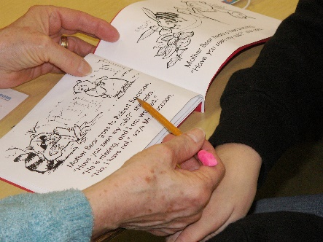
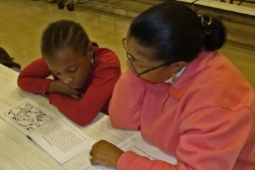

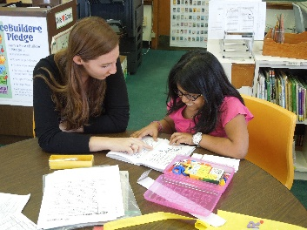
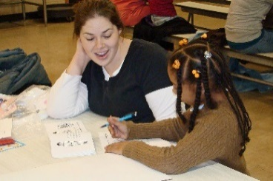
When Reading with Your Student
DO THIS…
BEFORE Reading DURING Reading AFTER Reading
Preview the book’s Listen for strategies Close the book and
cover, title, and the child is using to ask the child to retell
illustrations, and self correct, for the book’s beginning,
number of pages. significant errors, middle, and end.
and for looks of
Predict what or who it confusion. Ask probing Ask questions - “What
might be about. Ask questions. if…” or “How would
what the child already you…” Their responses
knows about it. Support by reading extend their thinking
to the child with beyond the text.
Prepare the child by inflection and attention
explaining specific to punctuation.
words and background
concepts that may be Stop on each page
challenging. Give to check for Complete the A-Z
examples. Write new understanding. Ask materials included in
vocabulary words on to retell what was just your curriculum packet:
index cards. read, or word meaning. → Comprehension Quiz
→ Graphic Organizer
Praise – be honest → Vocabulary Game and specific…and
always positive.

Slide 26

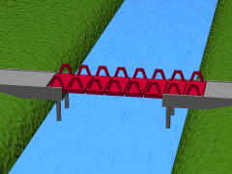
Reading with Your Student
DON’T DO THIS…
Don’t tell them a word immediately. Instead, count 10 seconds to let them figure out the word themselves using strategies.
Then, help by suggesting some strategies to them:
  sound out the word parts: /un-der-stand/
  Look at illustration clues: knight
  Ask what fits in the sentence.
She used ?what? to cut the string. /scissors/
Don’t assume the child knows specific terms. Ask them to name objects in the pictures, and introduce new vocabulary meanings.
For example, river → man-made canal.
Don’t correct every reading mistake if the word they use makes sense and does not change the meaning or understanding of the passage.
For example: “The cats hid under the table.”
Do NOT correct when:
“The cats run and hid/hide under the table.”
Do correct when:
“The kid ran under the tree.”

Slide 27
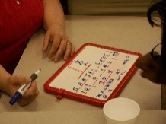
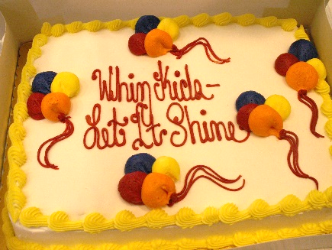
ENGAGING STUDENTS
How to Encourage a Reluctant Reader
X
O
Turn reading into a simple game that really works. First get the student’s interest by drawing a tic-tac-toe board. Ask if he/she wants to play. Probably “yes.” Have the student choose Xs or Os. Explain the game: The student reads the first page and afterward you ask a question from the page (the meaning of a word; about a character trait, fact, or happening; or about an illustration). Only if the student answers correctly can he/she put a mark on the board. The student may look back on the page to find the answer. Next, you read a page and the student asks you a question from the page. If you answer correctly, you enter your mark. However, you do not get to look back on the page. The first person to get 3 in a row wins the game. Try it. It works!
Rewarding Students:
  Check with your Site Leader concerning limitations on tangible rewards and gifts of food and trinkets. Consider how it can affect the other children in the room.
  - Be careful. If rewards are expected, they become taken for granted and ineffective in promoting
  internal motivation.
  - Try a big smile, fist bump, time for a favorite game, positive note home, or bragging to a site leader
  about a specific accomplishment. Younger kids love stickers, too.
  - Kids love to use dry erase boards to complete graphic organizers or play games.
  - Your Site Leader may provide a special whole group fun day or party every 6-8 weeks.
  These are also good incentives for attendance and good effort or behavior.

Slide 28
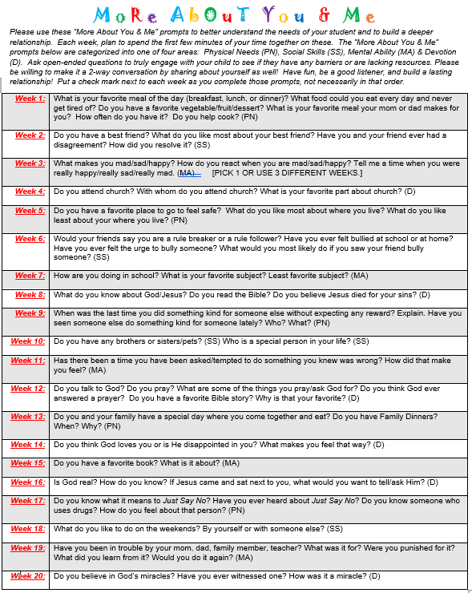
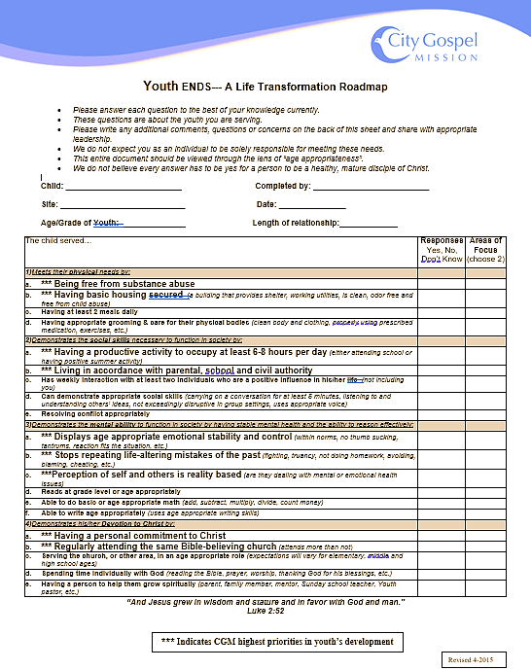
Building Relationships – “More About You & Me”
Your City Gospel Mission Whiz Kids Team has developed a simple, rewarding activity to help our volunteers better understand the needs of their students and to build a deeper relationship.
Use these “More About You & Me” conversation prompts each week. Plan to begin the first few minutes of your time together by each sharing your answers to one of these questions.
Make it fun and reflective.
Your Site Leader will provide you
with these documents
The “More About You & Me” prompts are categorized into one of the four areas: Physical Needs (PN), Social Skills (SS), Mental Ability (MA) & Devotion (D). This should aid in helping tutors better complete the ENDs document in the latter part of the Whiz Kids year.

Slide 29
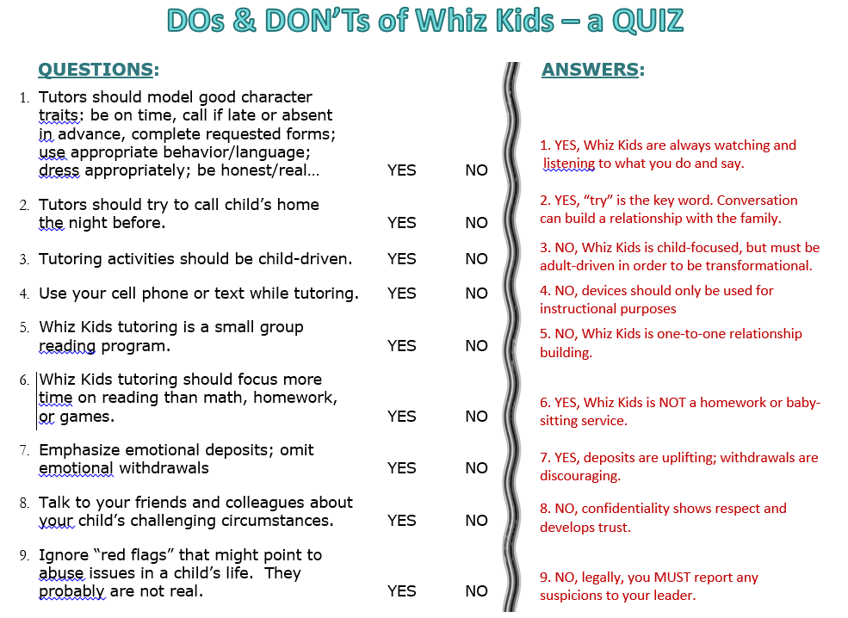

Slide 30
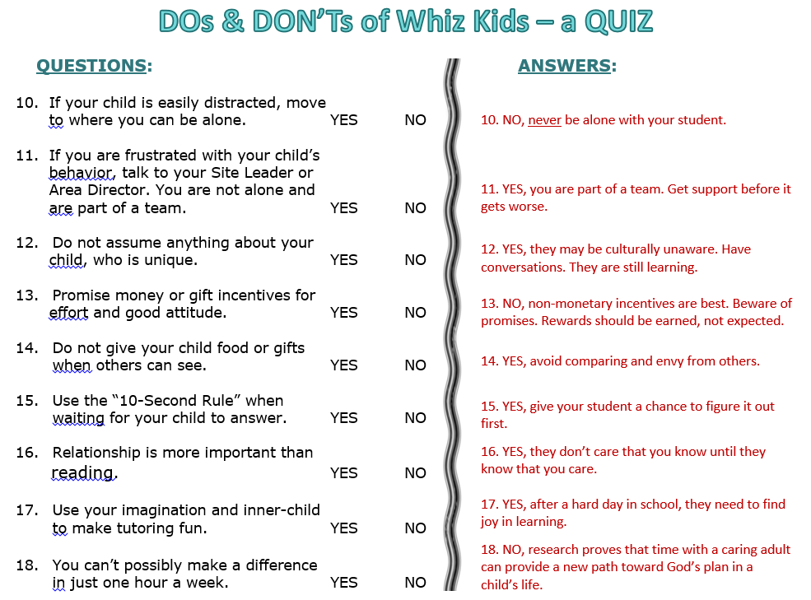

Slide 31


Always remember -
Thank you
for making
Jesus smile!

